Slide 1
Lab1 - PIC18F4520 Integrated Development Environment & Instruction Set
張庭翊

Slide 2
Outline
Development Environment Setup
Instruction Set Introduction
Lab
Reference

Slide 3
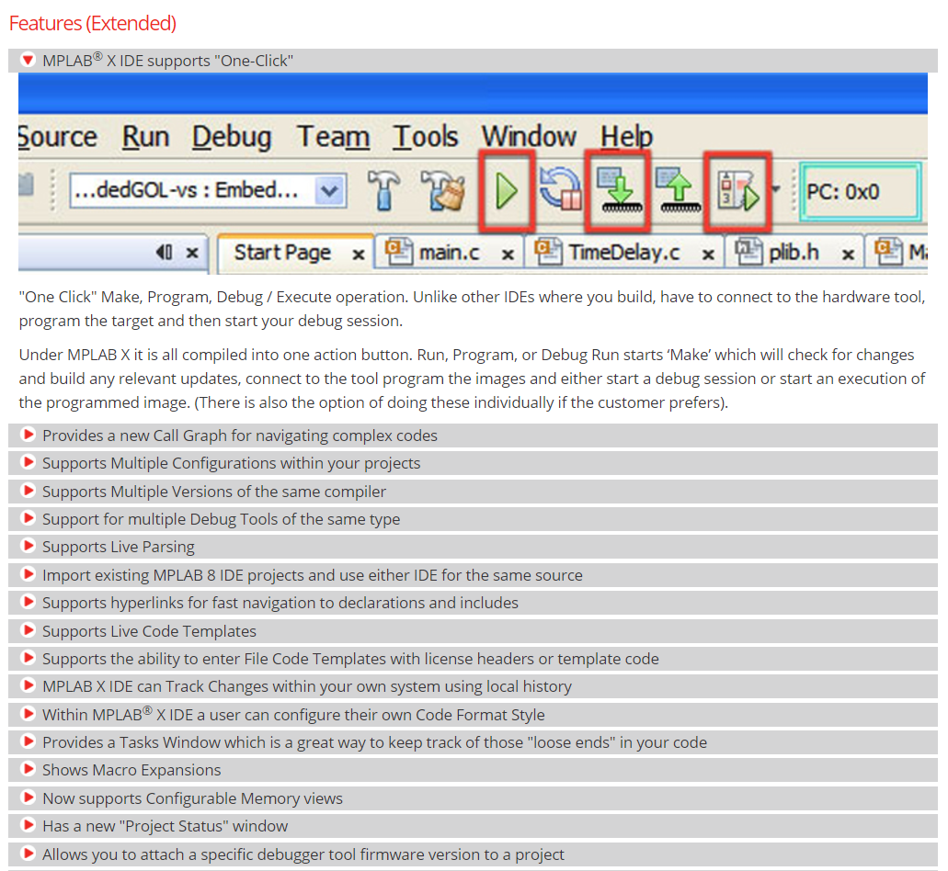
Development environment & setup
MPLAB® X IDE
  Features:
  http://www.microchip.com/mplab/mplab-x-ide

Slide 4
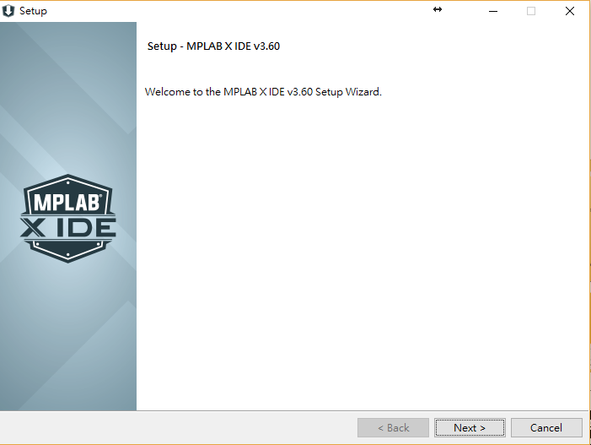
MPLAB® X IDE
下載&安裝(v3.61)

Slide 5
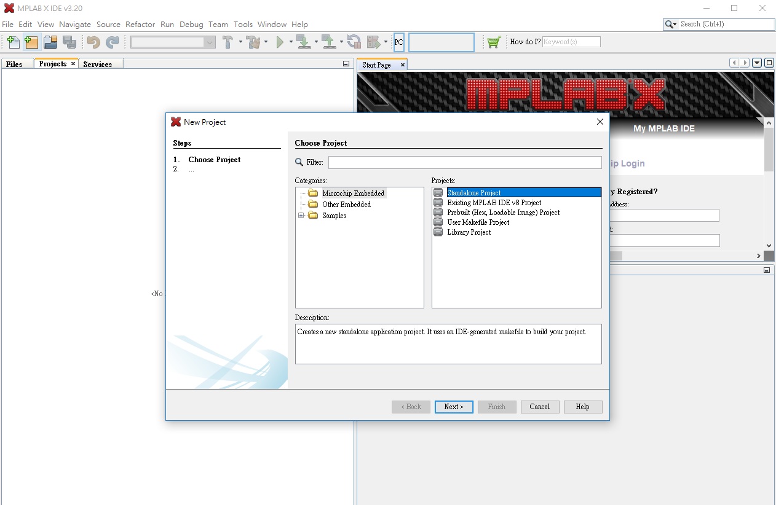
Development environment & setup
Create New Project

Slide 6
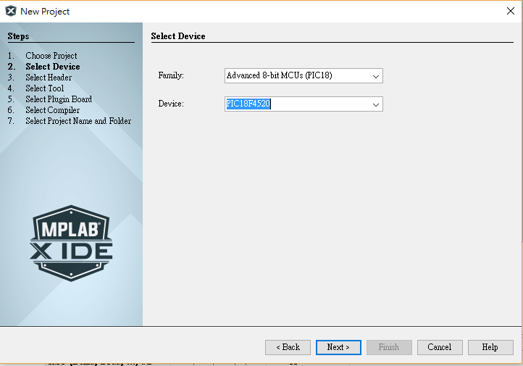
Development environment & setup
Create New Project

Slide 7
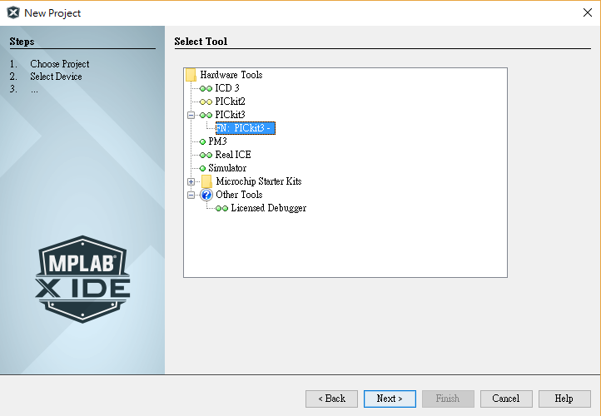
Development environment & setup
Create New Project

Slide 8
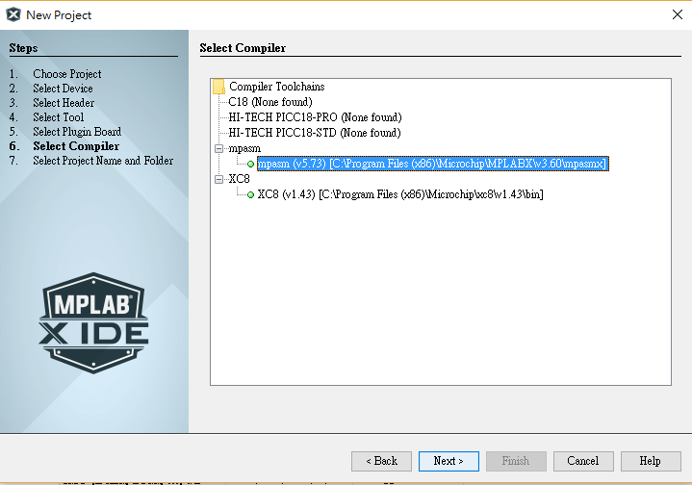
Development environment & setup
Create New Project

Slide 9
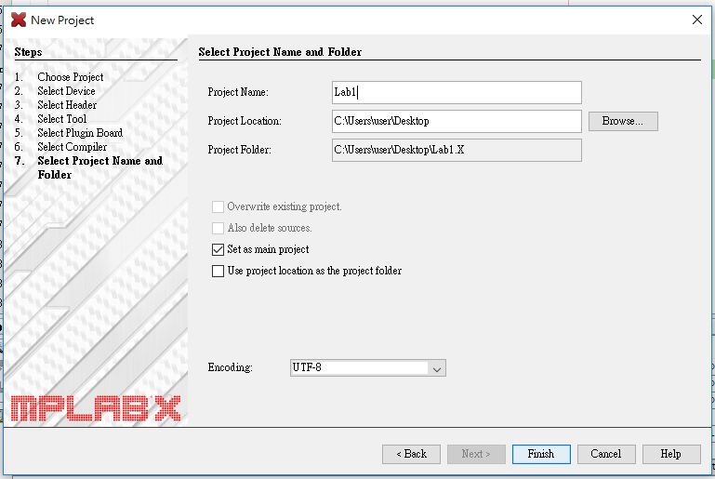
Development environment & setup
Create New Project

Slide 10
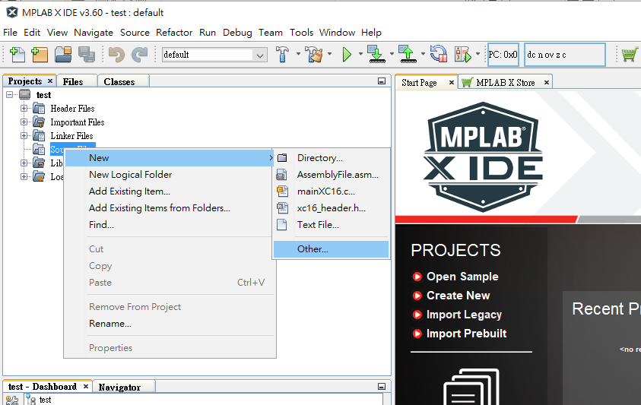
Development environment & setup
專案管理→Source Files點選右鍵→new→AssemblyFile.asm

Slide 11
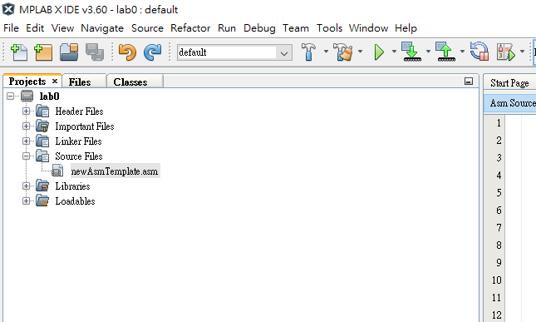
Development environment & setup
Run

Slide 12
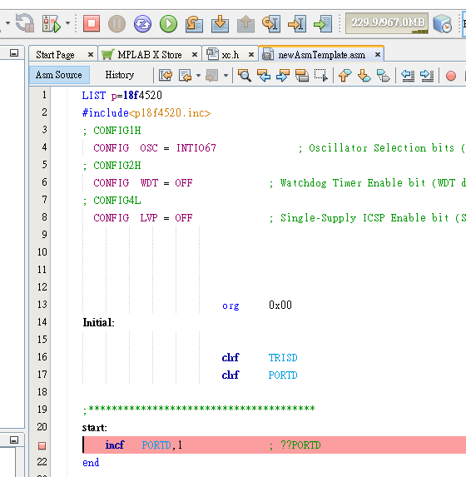
Development environment & setup
Debug&燒錄
逐步執行
執行下一步
停止除錯執行
暫停
中斷點

Slide 13
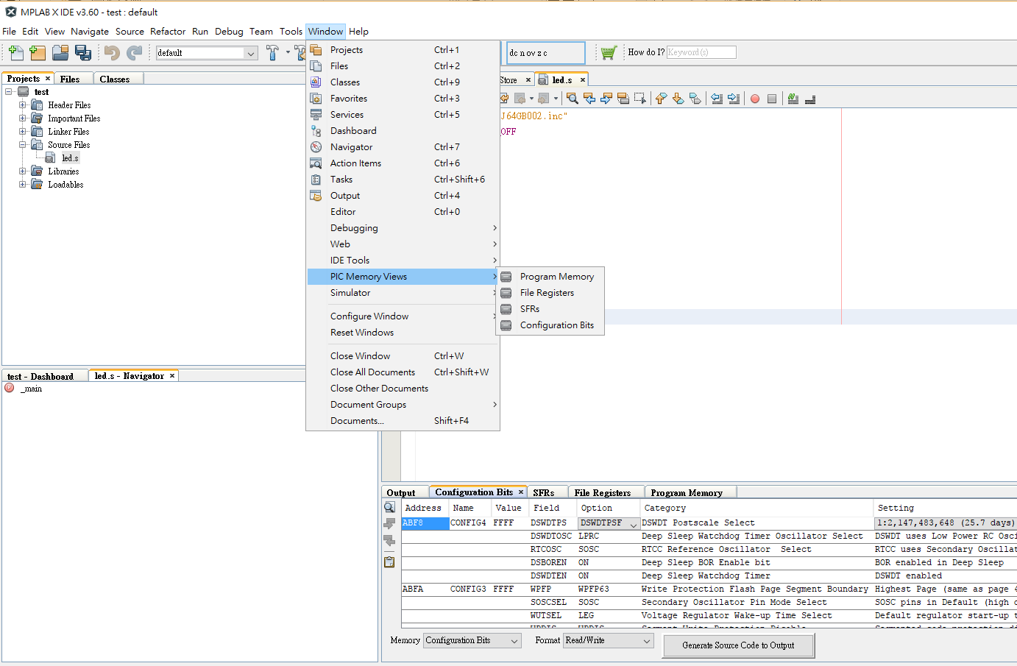
Development environment & setup

Slide 14
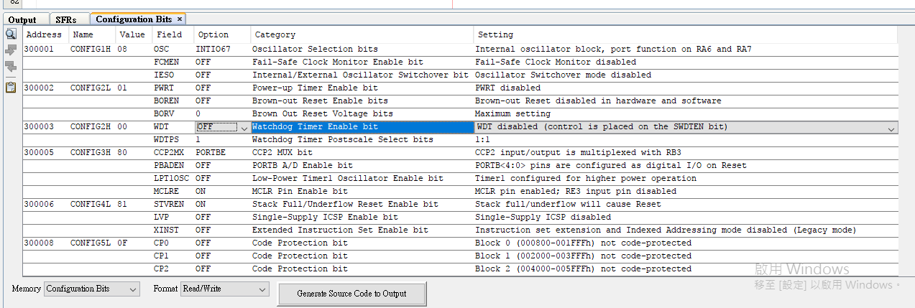
Development environment & setup

Slide 15
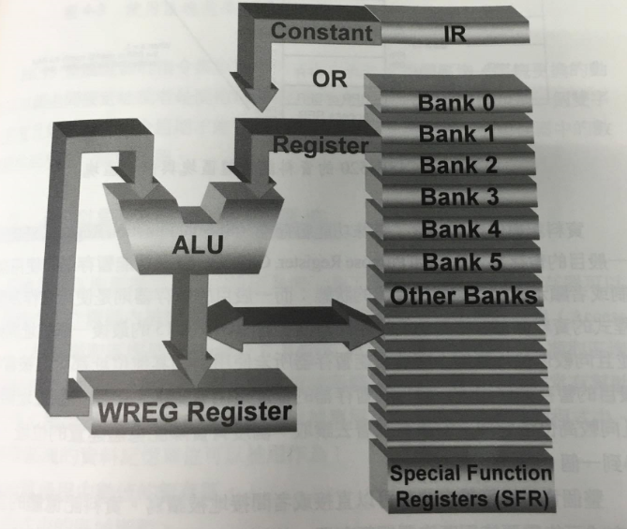
Special Function Registers (SFRs)
WREG用於:
資料的暫存
資料搬移
運算元的存放

Slide 16
Promgram Counter
Program Counter(PC):負責儲存CPU下一次所要執行的記憶體位址。
由於PIC18F4520是16 bit長度指令的硬體，所以每一個指令占兩個byte的記憶體空間，所以每執行完一個指令後，PC的位址會加2而指向下一個指令的位址。

Slide 17
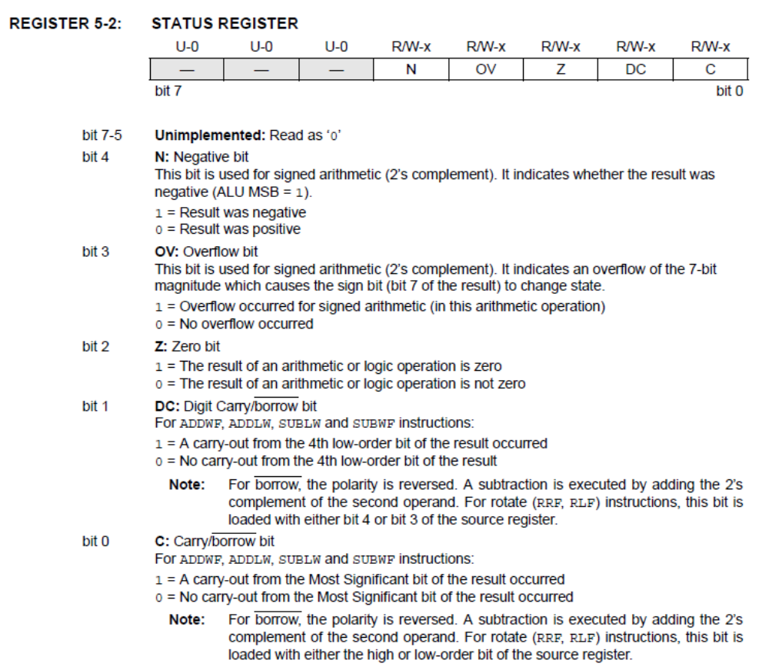
STATUS Register
Contains the arithmetic status of the Arithmetic Logic Unit (ALU)

Slide 18
ALU Status Register (SR)
N(Negative flag): 0
Z(Zero flag): 0
1
1
0x35
+0x82
0xB7
0011 0101
+ 1000 0010
1011 0111
0x41
0x41
0x00
MSB=1
Result = 0
C(Carry bit): 0
1
1
OV(Overflow flag): 0
0xD5
+ 0xC2
0x97
1101 0101
+ 1100 0010
11001 0111
0x95
+ 0x82
0xA7
1001 0101
+ 1000 0010
0001 0111
Carry bit =1
Signed overflow

Slide 19
  PIC18F4520
  Instruction set

Slide 20
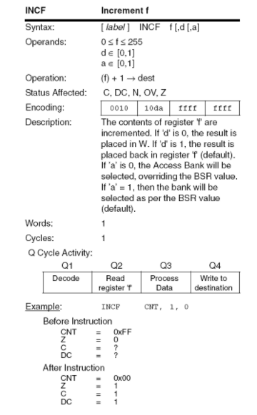
Instruction set
INCF—Increment f

Slide 21
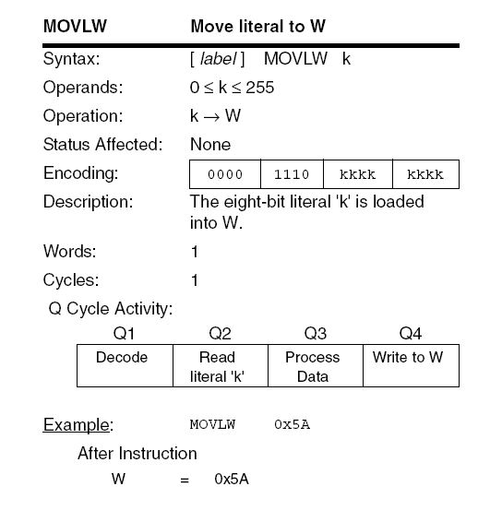
Instruction set
MOVLW—Move
literal to W

Slide 22
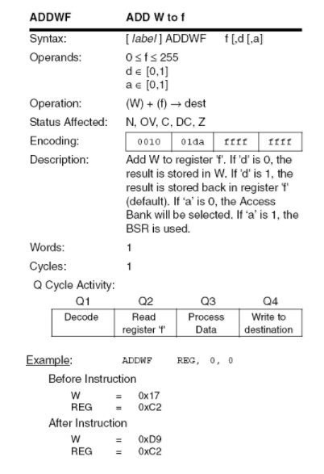
Instruction set
ADDWF—Add WREG to f

Slide 23
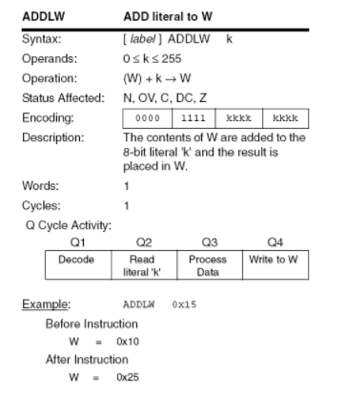
Instruction set
ADDLW—Add literal to W

Slide 24
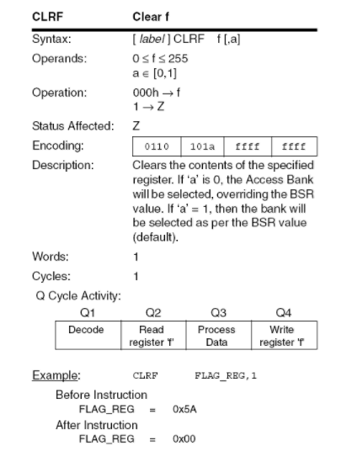
Instruction set
CLFR—Clear f

Slide 25
Reference
http://ww1.microchip.com/downloads/en/devicedoc/39631a.pdf
http://www.microchip.com/mplab/mplab-x-ide
http://technology.niagarac.on.ca/staff/mboldin/18F_Instruction_Set/

